Slide 1



Infection control moment
An introduction to PROJECT FIRSTLINE
By Helen Horton, BSN, RN

Slide 2


WHAT IS PROJECT FIRST LINE?
Click to watch the video

Slide 3
HOW IS CCBNC INVOLVED?
CCBNC IS A PARTNER!
CCBNC Ambassadors:
  Erma Smith-King, Lead
  Angeline Baker
  Helen Horton
Our goal is to present one Infection Control a month at regular meetings
We will post information on our social media venues
We will provide education sessions to nurses in the community
We will report our results to the Project Firstline Team/Administrators

Slide 4
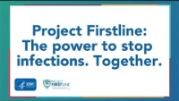
The power to stop infections together click to watch the video

Slide 5

Thank you for your support and participation!
Please take a moment to let us know your thoughts about the first Infection Control Moment.
Email your comment(s) to ccbncinc@gmail.com
Enter “Moment #1” in the subject line

